Slide 1
Where clause in SQL
The SQL WHERE Clause
The WHERE clause is used to filter records.
It is used to extract only those records that fulfill a specified condition.

Slide 2
Where clause in SQL
The SQL WHERE Clause
SELECT column1, column2, ...
FROM table_name
WHERE condition;

Slide 3
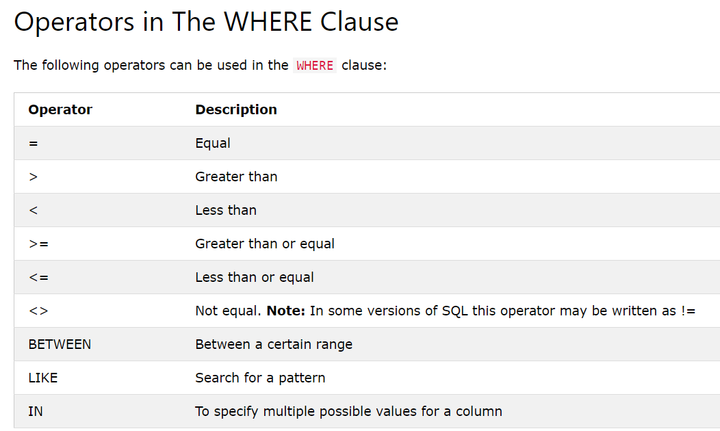
Where clause in SQL

Slide 4
Where clause in SQL
SQL AND, OR and NOT Operators
The AND and OR operators are used to filter records based on more than one condition:
The AND operator displays a record if all the conditions separated by AND are TRUE.
The OR operator displays a record if any of the conditions separated by OR is TRUE.
The NOT operator displays a record if the condition(s) is NOT TRUE.

Slide 5
Where clause in SQL
SQL AND, OR and NOT Operators
SELECT * FROM Customers
WHERE Country='Germany' AND City='Berlin’;
SELECT * FROM Customers
WHERE Country='Germany' OR Country='Spain’;
SELECT * FROM Customers
WHERE NOT Country='Germany';

Slide 6
Where clause in SQL
SQL AND, OR and NOT Operators
SELECT * FROM Customers
WHERE Country='Germany' AND (City='Berlin' OR City='München’);

Slide 7
Where clause in SQL
The IN operator allows you to specify multiple values in a WHERE clause.
The IN operator is a shorthand for multiple OR conditions.
SELECT * FROM Customers
WHERE Country IN ('Germany', 'France', 'UK’);
SELECT * FROM Customers
WHERE Country NOT IN ('Germany', 'France', 'UK');

Slide 8
Where clause in SQL
The IN operator allows you to specify multiple values in a WHERE clause.
The IN operator is a shorthand for multiple OR conditions.
SELECT * FROM Customers
WHERE Country IN ('Germany', 'France', 'UK’);
SELECT * FROM Customers
WHERSELECT * FROM Customers
WHERE Country IN (SELECT Country FROM Suppliers);E Country NOT IN ('Germany', 'France', 'UK');

Slide 9
Where clause in SQL
The SQL LIKE Operator
The LIKE operator is used in a WHERE clause to search for a specified pattern in a column.
There are two wildcards often used in conjunction with the LIKE operator:
The percent sign (%) represents zero, one, or multiple characters
The underscore sign (_) represents one, single character

Slide 10
Where clause in SQL
The SQL LIKE Operator
SELECT * FROM Customers
WHERE CustomerName LIKE 'a%’;
SELECT * FROM Customers
WHERE CustomerName LIKE '%a’;
SELECT * FROM Customers
WHERE CustomerName LIKE '%or%’;
SELECT * FROM Customers
WHERE CustomerName LIKE '_r%’;
SELECT * FROM Customers
WHERE CustomerName LIKE 'a__%';

Slide 11
Constraints in SQL
Constraints are the rules that we can apply on the type of data in a table.
That is, we can specify the limit on the type of data that can be stored in a particular column in a table using constraints.

Slide 12
Constraints in SQL
The available constraints in SQL are:
NOT NULL: This constraint tells that we cannot store a null value in a column.
UNIQUE: This constraint when specified with a column, tells that all the values in the column must be unique. That is, the values in any row of a column must not be repeated.
PRIMARY KEY: A primary key is a field which can uniquely identify each row in a table. And this constraint is used to specify a field in a table as primary key.(unique + not null)

Slide 13
Constraints in SQL
FOREIGN KEY: A Foreign key is a field which can uniquely identify each row in another table. And this constraint is used to specify a field as Foreign key.
CHECK: This constraint helps to validate the values of a column to meet a particular condition. That is, it helps to ensure that the value stored in a column meets a specific condition.
DEFAULT: This constraint specifies a default value for the column when no value is specified by the user.

Slide 14
Constraints in SQL
How to specify constraints?
We can specify constraints at the time of creating the table using CREATE TABLE statement.
We can also specify the constraints after creating a table using ALTER TABLE statement.

Slide 15
Constraints in SQL
NOT Null
CREATE TABLE Student
(
ID int(6) NOT NULL,
NAME varchar(10) NOT NULL,
ADDRESS varchar(20)
);

Slide 16
Constraints in SQL
UNIQUE
CREATE TABLE Student
(
ID int(6) UNIQUE,
NAME varchar(10),
ADDRESS varchar(20)
);

Slide 17
Constraints in SQL
PRIMARY KEY
CREATE TABLE Student
(
ID int(6),
NAME varchar(10),
ADDRESS varchar(20),
PRIMARY KEY(ID)
);

Slide 18
Constraints in SQL
Check Constraint
CREATE TABLE Student
(
ID int(6) NOT NULL,
NAME varchar(10) NOT NULL,
AGE int CHECK (AGE >= 18)
);

Slide 19
Constraints in SQL
Check Constraint
CREATE TABLE pets(
ID INT NOT NULL,
Name VARCHAR(30) NOT NULL,
Breed VARCHAR(20) NOT NULL,
Age INT,
GENDER VARCHAR(9),
PRIMARY KEY(ID),
check(GENDER in ('Male', 'Female', 'Unknown'))
);

Slide 20
Constraints in SQL
Check Constraint
CREATE TABLE employees (
emp_id INT NOT NULL PRIMARY KEY,
emp_name VARCHAR(55) NOT NULL,
hire_date DATE NOT NULL,
salary INT NOT NULL CHECK (salary >= 3000 AND salary <= 10000),
dept_id INT
);

Slide 21
Constraints in SQL
Default Constraint
Create Table My_Table1
(
IId int default(1500),
Age int,
Salary int default(100)
);

Slide 22
Constraints in SQL
Alter Command
ALTER TABLE Student MODIFY s_id int NOT NULL;
ALTER TABLE Student MODIFY age INT NOT NULL UNIQUE;
ALTER table Student ADD PRIMARY KEY (s_id);

Slide 23
Constraints in SQL
Alter Command
With alter: Check constraint can also be added to an already created relation using the syntax:
alter table TABLE_NAME modify COLUMN_NAME check(Condition);
Example : alter table dept add check(deptid > 5);
Giving variable name to check constraint:Check constraints can be given a variable name using the syntax:
alter table TABLE_NAME add constraint CHECK_CONST check (Condition);
alter table TABLE_NAME drop check CHECK_CONST_NAME;

Slide 24
Constraints in SQL
Foreign Key Constraint
Foreign Key is used to relate two tables. The relationship between the two tables matches the Primary Key in one of the tables with a Foreign Key in the second table.
This is also called a referencing key.
We use ALTER statement and ADD statement to specify this constraint.

Slide 25
Constraints in SQL
Customer_Detail Table
c_id Customer_Name address
101 Adam Noida
102 Alex Delhi
103 Stuart Rohtak

Slide 26
Constraints in SQL
Order_Detail Table
Order_id Order_Name c_id
10 Order1 101
11 Order2 103
12 Order3 102

Slide 27
Constraints in SQL
CREATE table Order_Detail(
order_id int PRIMARY KEY,
order_name varchar(60) NOT NULL,
c_id int FOREIGN KEY REFERENCES Customer_Detail(c_id)
);

Slide 28
Constraints in SQL
CREATE table Order_Detail(
order_id int PRIMARY KEY,
order_name varchar(60) NOT NULL,
c_id int FOREIGN KEY REFERENCES Customer_Detail(c_id)
);
ALTER table Order_Detail ADD FOREIGN KEY (c_id) REFERENCES Customer_Detail(c_id);

Slide 29
Constraints in SQL
Behaviour of Foriegn Key Column on Delete
There are two ways to maintain the integrity of data in Child table, when a particular record is deleted in the main table.
When two tables are connected with Foriegn key, and certain data in the main table is deleted, for which a record exits in the child table, then we must have some mechanism to save the integrity of data in the child table.

Slide 30
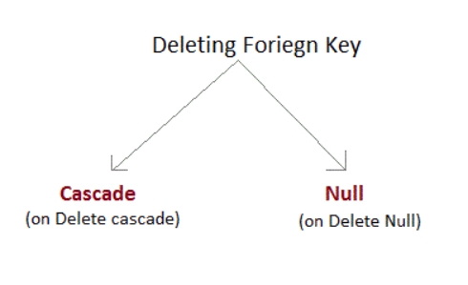
Constraints in SQL
Behaviour of Foriegn Key Column on Delete

Slide 31
Constraints in SQL
Behaviour of Foriegn Key Column on Delete
1. On Delete Cascade : This will remove the record from child table, if that value of foriegn key is deleted from the main table.
2. On Delete Null : This will set all the values in that record of child table as NULL, for which the value of foriegn key is deleted from the main table.
3. If we don't use any of the above, then we cannot delete data from the main table for which data in child table exists. We will get an error if we try to do so.
ERROR : Record in child table exist

Slide 32
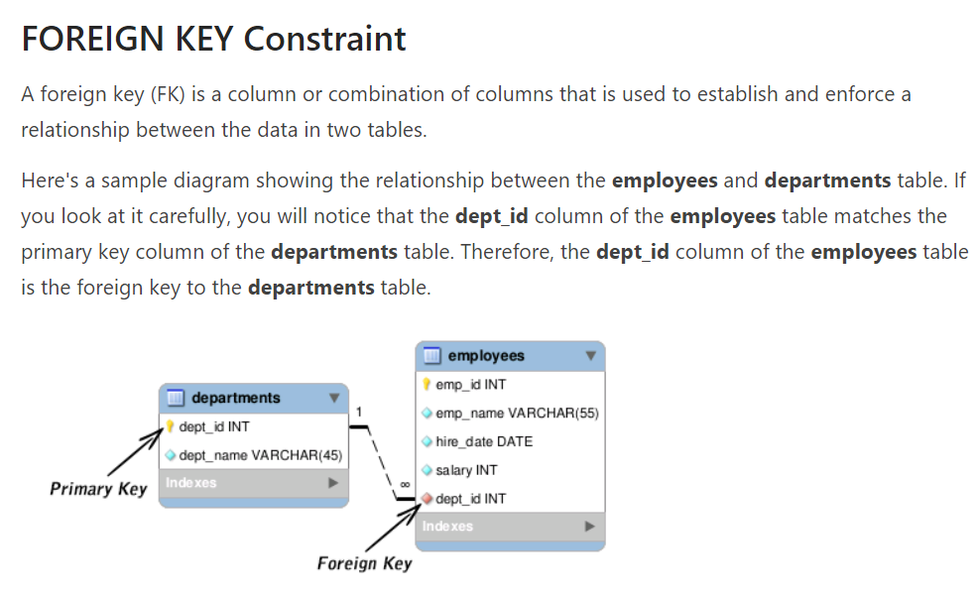
Constraints in SQL

Slide 33
Constraints in SQL
CREATE TABLE employees (
emp_id INT NOT NULL PRIMARY KEY,
emp_name VARCHAR(55) NOT NULL,
hire_date DATE NOT NULL,
salary INT,
dept_id INT); ,
FOREIGN KEY (dept_id) REFERENCES departments(dept_id)
);

